Slide 1
ERAU ASCEND! Spring 2022
Team MEMBERS
NICODEMUS PHAKLIDES (EE)
ZACHARY HOWE (AS)
Somaralyz grullon (ME)
ISSAC JUAN (ME)
MICHAEL LAUBER (AE)
JULIAN TURNER (ME)
MENTORS
DR. DOUGLAS ISENBERG (ME)
DR. YABIN LIAO (AE)
SPECIAL THANKS
Arizona NEAR SPACE Research
Arizona Space Grant Consortium
UNDERGRADUATE RESEARCH INSTITUDE
DR. ANNE BOETTCHER (URI)
Dr. Ahmed I. Sulyman (CESE)
PAUL KAUP (STEM+C)

Slide 2
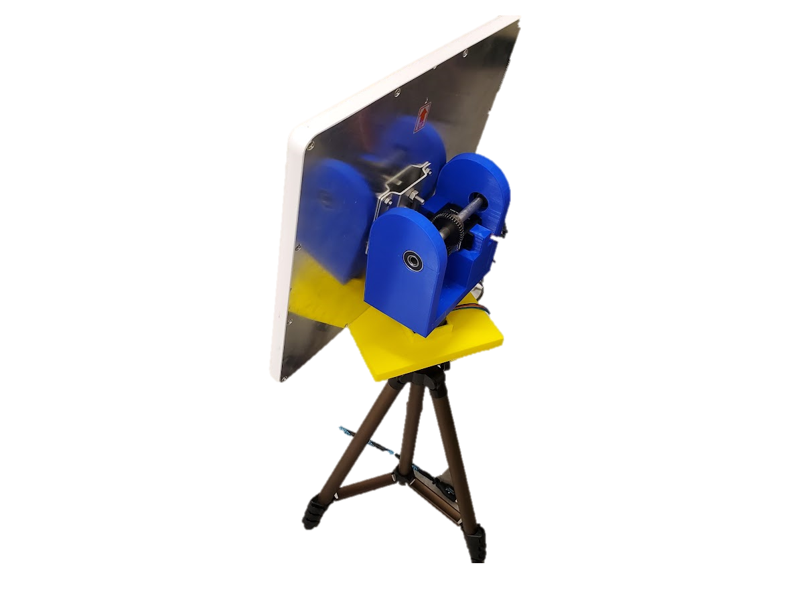
Mission OVERVIEW
Our high-altitude balloon payload will live stream video and data over three radio systems
2.4 GHz Video Stream
1.3 GHz Video Stream
900 MHz Telemetry Link
Balloon Payload
Up to100,000 ft
Tracking Antenna

Slide 3
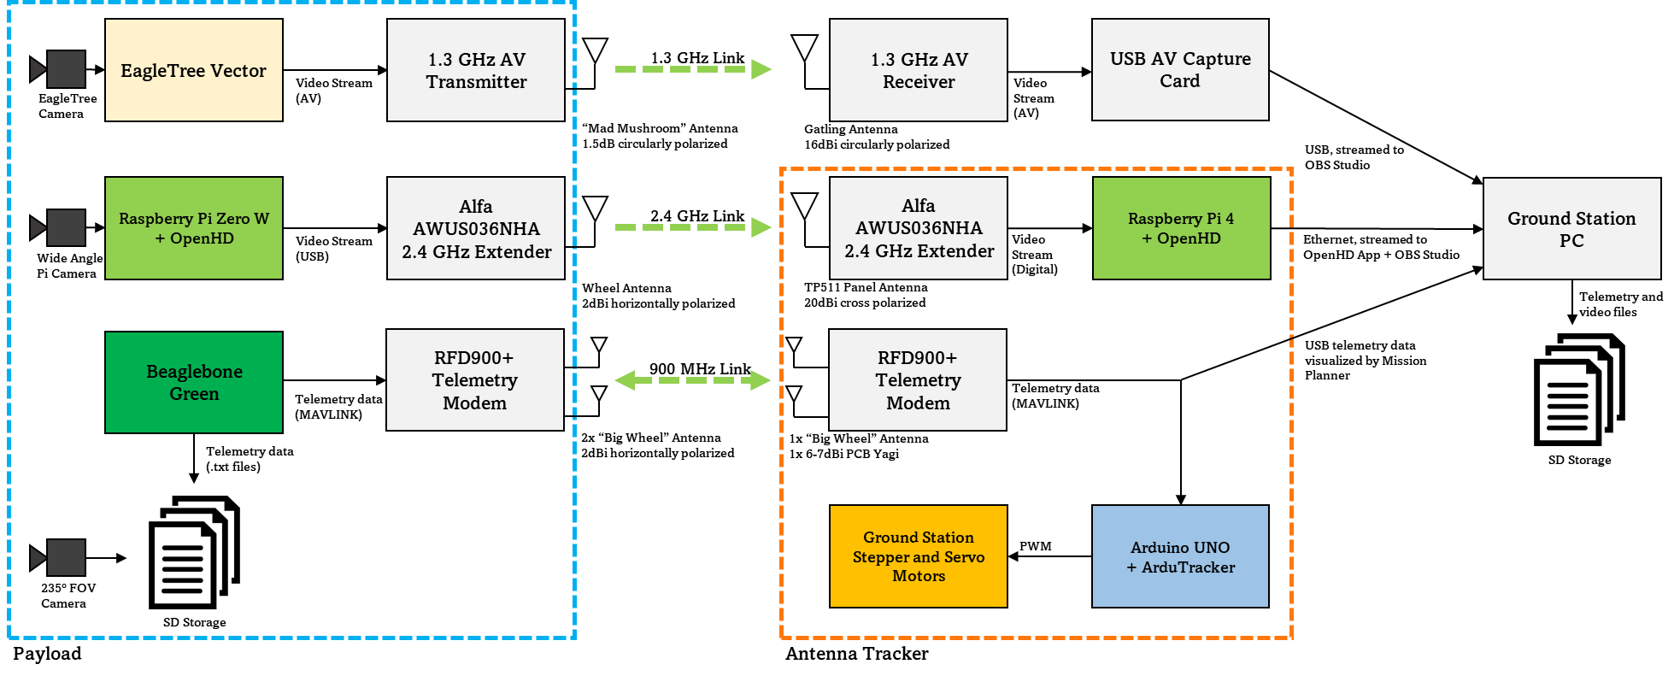
LIVE STREAMING EXPERIMENT

Slide 4
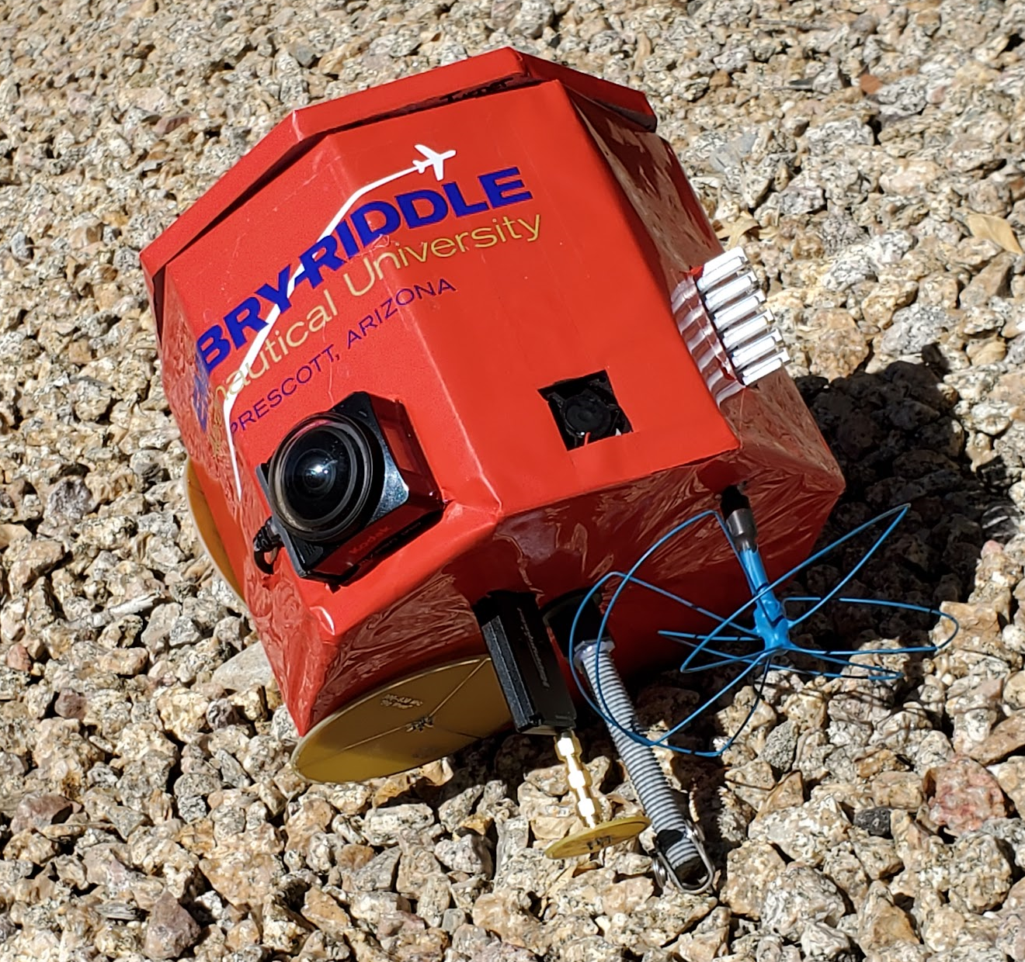
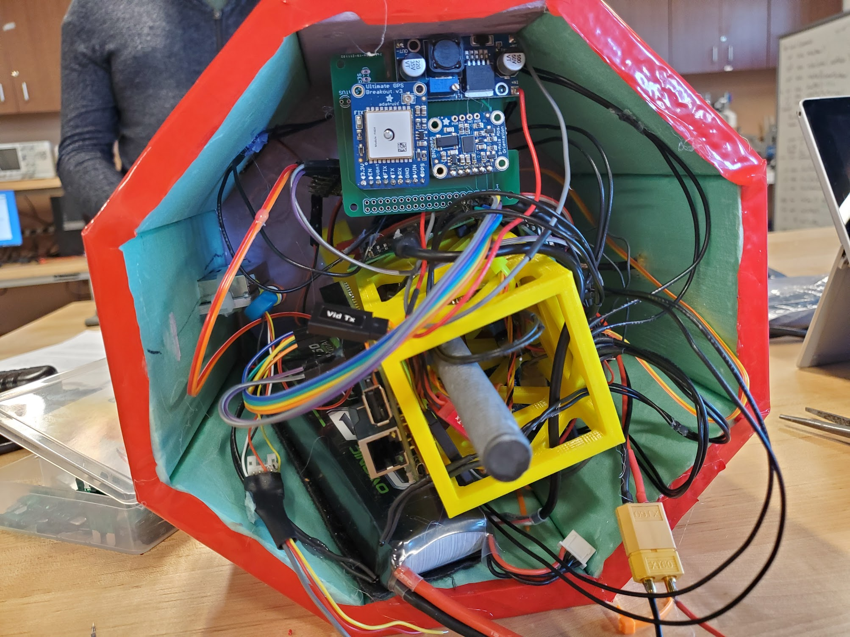
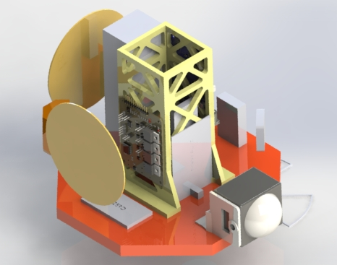
STRUCTURE
Made of Foam
Wrapped in thin vinyl
Central spine keeps payload rigid and sturdy

Slide 5
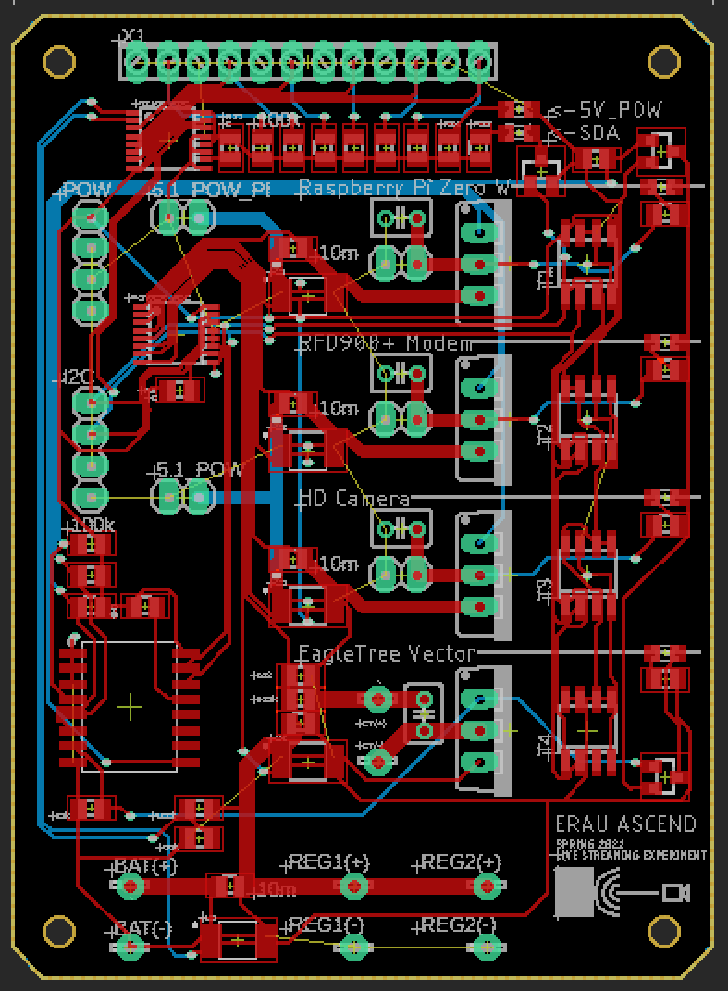
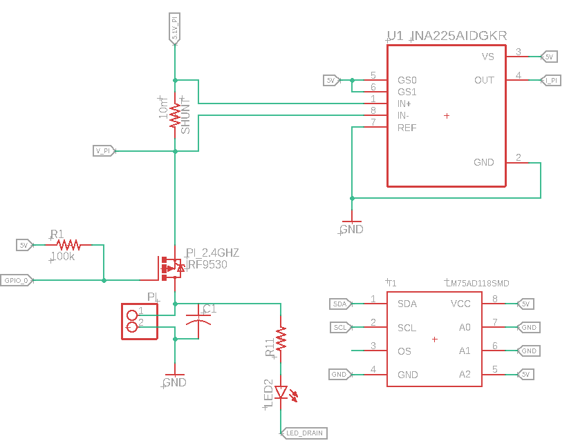
ELECTRONIC INTEGRATION
I²C Voltage, current, and temperature analytics on all peripherals
2x - ADS7828 I²C 8 Channel 12 bit ADC
4x - INA225A Current Monitor
4x - LM75A I²C Digital Temperature Sensor
1x – TCA9534A I²C 8 Channel I/O Expander

Slide 6
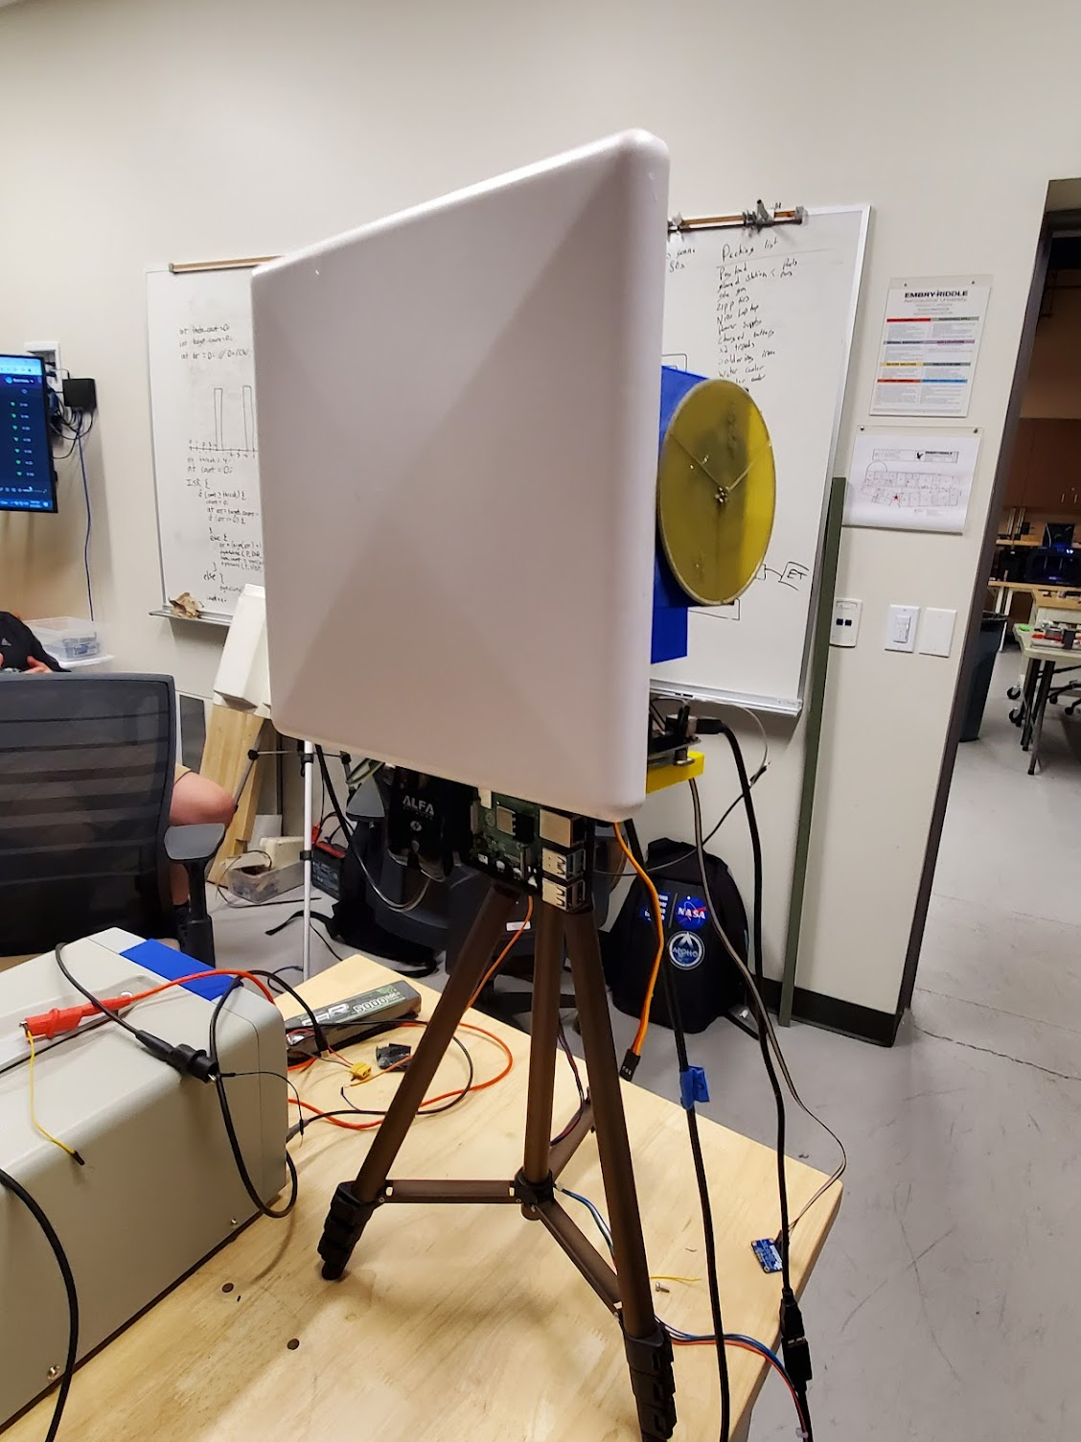
GROUND STATION
Ground Station
2.4GHz Open HD Video System
900MHz MAVLINK Telemetry System
Azimuth: NEMA 17 Stepper Motor
Elevation: 46kg-cm Servo Motor
Arduino interfaces with MissionPlanner for pointing

Slide 7
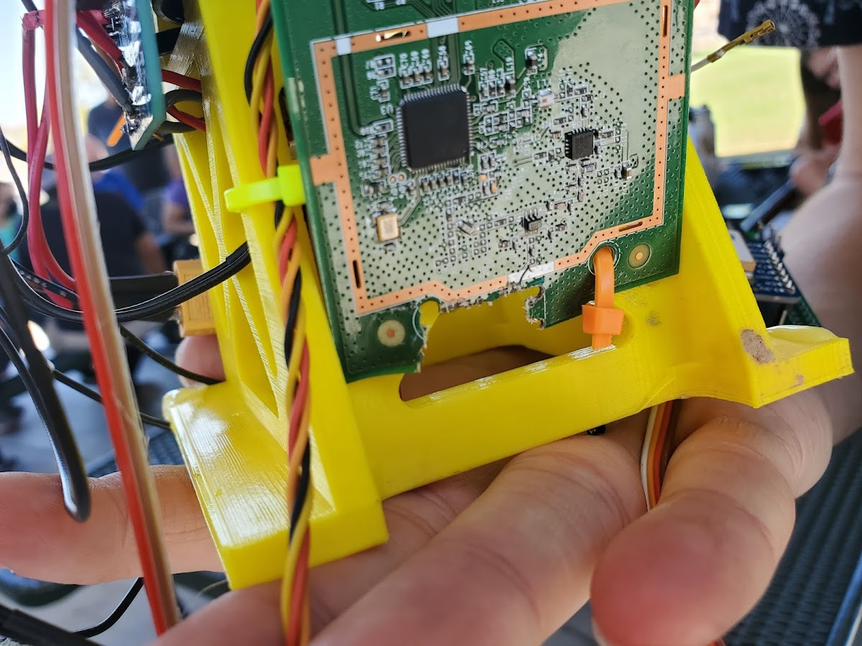
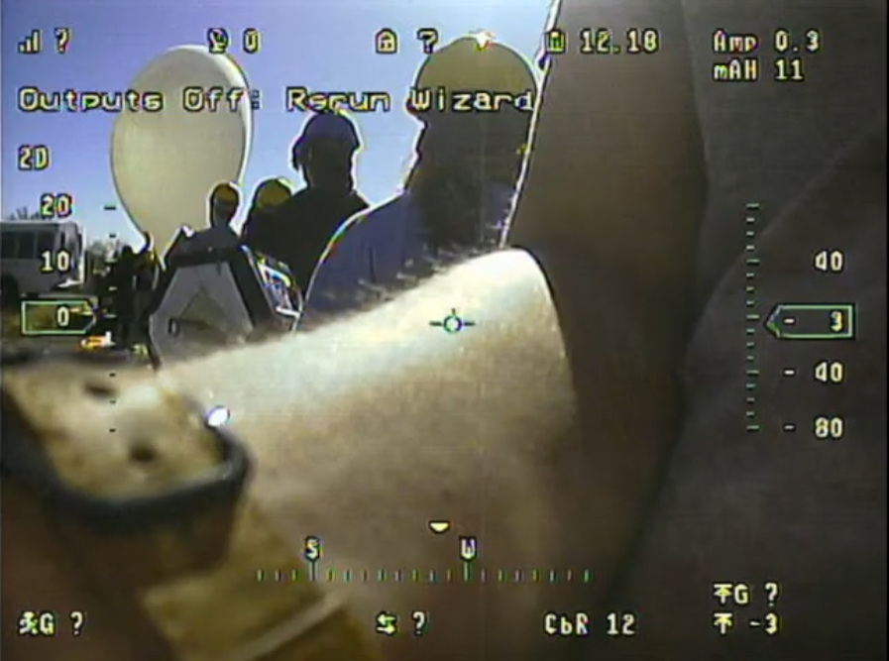
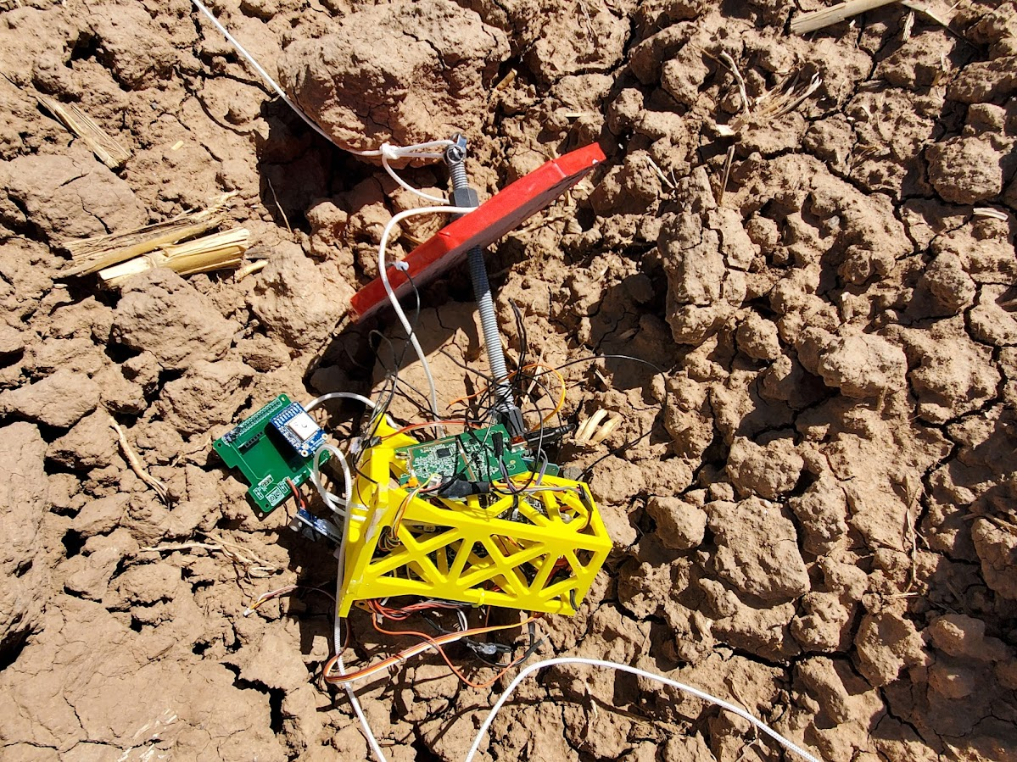
FLIGHT
Booted for 3 minutes and died, rebooted and died after1.5 minutes
All communications silent, boards off at takeoff
Entire payload sheared apart before recovery

Slide 8
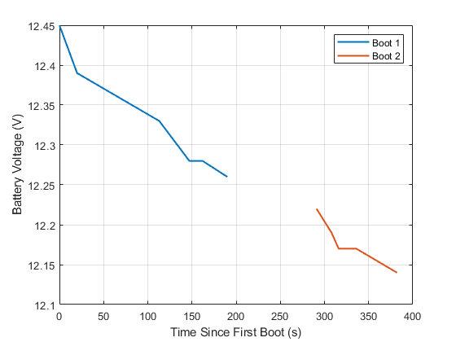
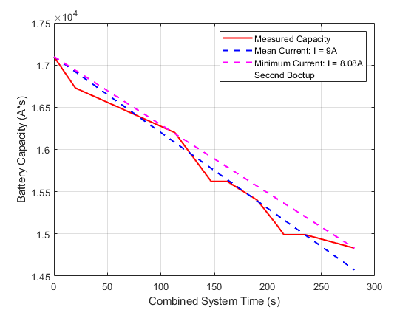
FLIGHT FORENSICS

Slide 9
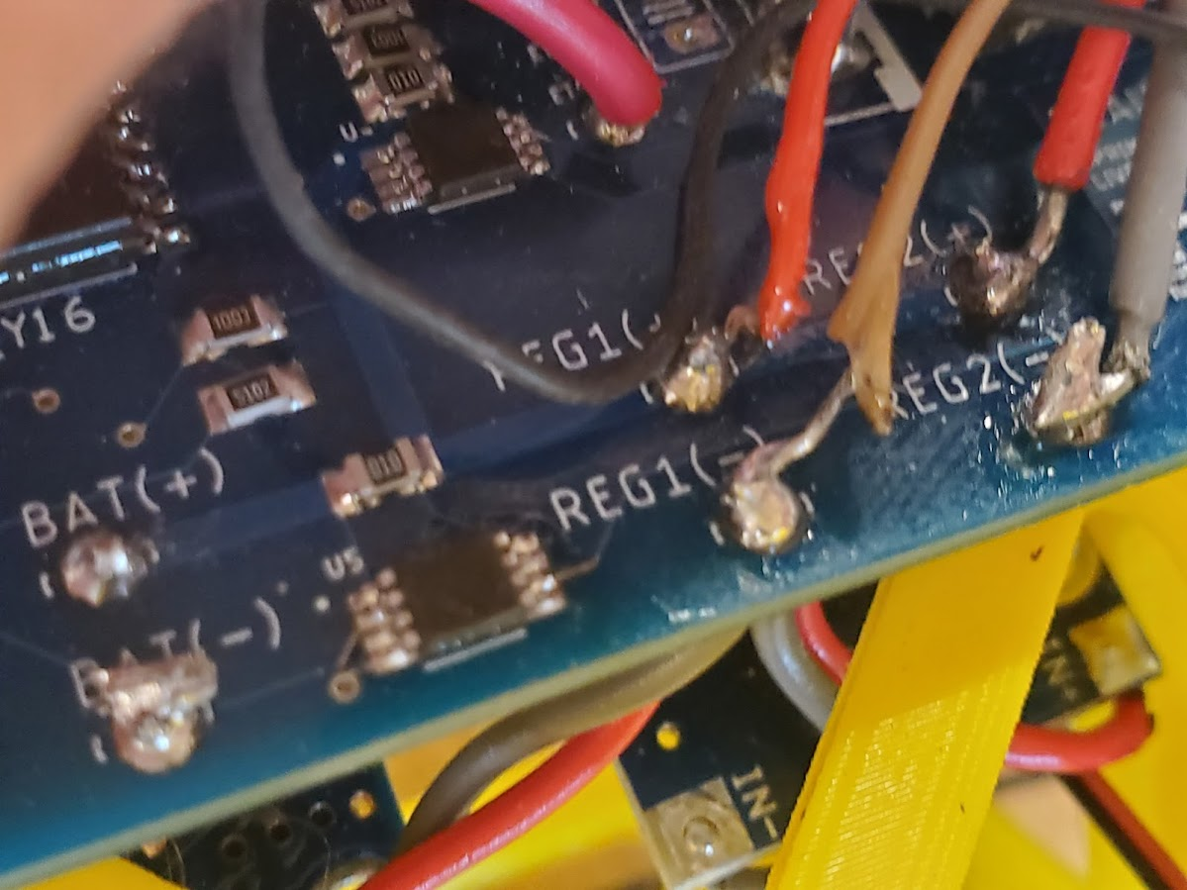
FLIGHT FORENSICS

Slide 10
THE SECOND PAYLOAD
Constructed a second payload in the week after launch
2.4GHz Video Streaming
900MHz Telemetry Link
Test ground station thoroughly

Slide 11
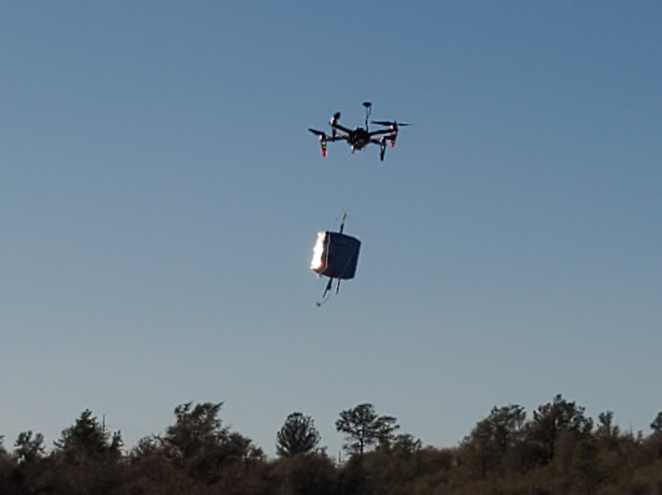
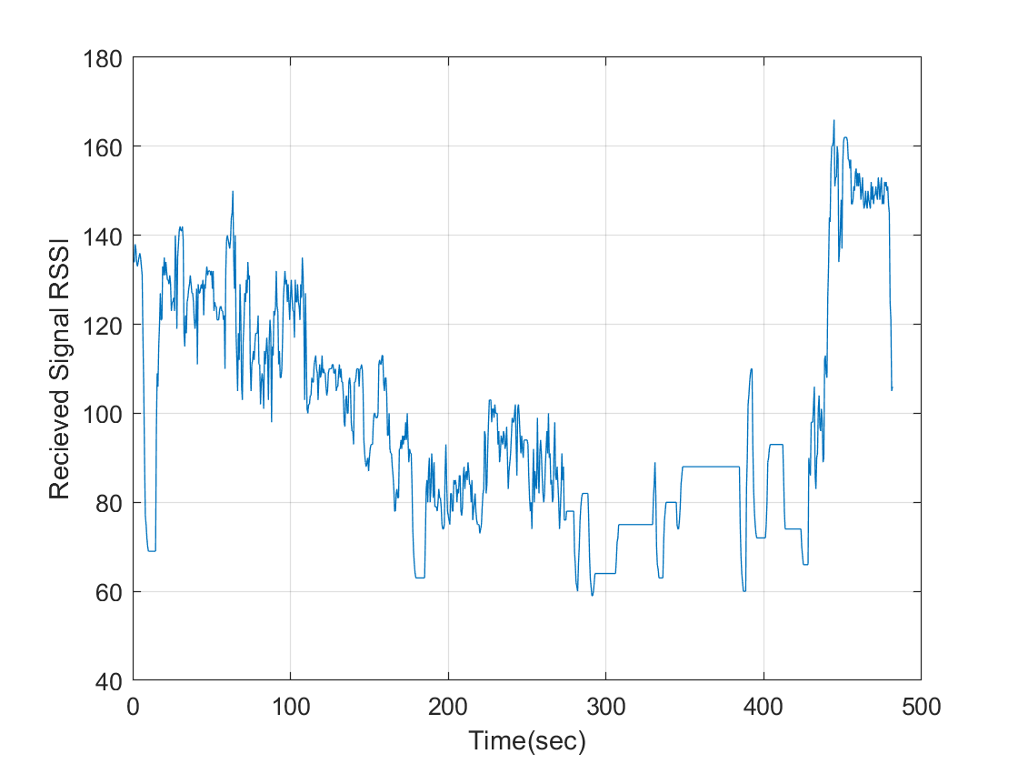
Testing

Slide 12
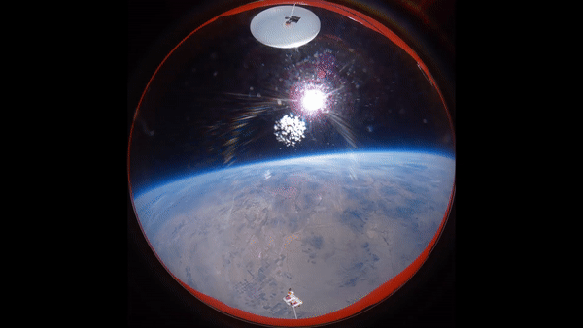
Questions

